Slide 1

CSS Locators Recap (:
David Lopez-Palmerin

Slide 2
Akin says:
“CSS locators are the best.”
This is de wey…
So I will show you de wey

Slide 3
Intro
CSS stands for Cascading Style Sheets
CSS is a style sheet language which describes the presentation of the HTML document
CSS Selectors are used to target the HTML elements on web page

Slide 4
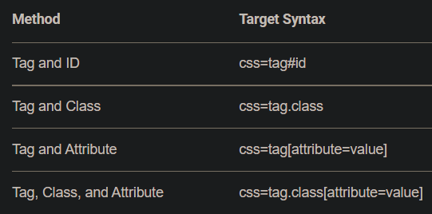
Intro - continued
CSS locators according to google, basics:
• tag = the HTML tag of the element being accessed
• . = the dot sign. This should always be present when using a CSS Selector with class
• class = the class of the element being accessed
• [ and ] = square brackets within which a specific attribute and its corresponding value will be placed
• attribute = the attribute to be used. It is advisable to use an attribute that is unique to the element such as a name or ID.
• value = the corresponding value of the chosen attribute.

Slide 5
CSS Selector: Select by ID
If the web element has an ID attribute you can use the ID attribute details in CSS selector
ID attribute in CSS Selector is symbolized by the hash (#) sign
Syntax : tagName#elementID
Example : input#first_name

Slide 6
Advanced CSS Selectors
(Advanced meaning you can use a mix of ID, className, and other attributes of webelements)
Syntax: tagName.classValue[AttributeName=‘AttributeValue’] tagName#idValue[AttributeName=‘AttributeValue’]
Example: input.signup[type=‘submit’][value=‘Sign me up’] input#submit_btn[type=‘submit’][value=‘Sign me up’]

Slide 7
CSS SUBSTRING MATCHING

Slide 8
CSS SELECTOR – SUB-STRING
Sub-string matches are very helpful in identifying dynamic webElements with the help of partial string matches
The 3 important special characters in CSS Substring are: ‘ ^ ‘ Sign – Signify’s the prefix of the text ‘ $ ‘ Sign – Signify’s the suffix of the text ‘ * ‘ Sign – Signify’s the sub-string of the text

Slide 9
CSS SELECTOR – SUB-STRING EXAMPLES
Match prefix of the text input[name^=‘country_c’]
Match suffix of the text input[name$=‘y_client’]
Match sub-string of the text input[name*=‘try_cl’]

Slide 10
FINDING DIRECT CHILD OR SUBCHILD

Slide 11
FINDING CHILD OR SUBCHILD ELEMENTS
Direct Child - Child combinator ( > ) is used to select direct child
- Syntax: tagName[AttributeName=‘AttributeValue’] > tagName[AttributeName=‘AttributeValue’]
- Example: select#country > option[value=‘AU’]
Child or SubChild - Descendant combinator ( ) is used to select Child or SubChild
- Syntax: tagName[AttributeName=‘AttributeValue’] tagName[AttributeName=‘AttributeValue’]
- Example: form#deorg_form div

Slide 12
PSEUDO CLASSES

Slide 13
CSS SELECTOR PSEUDO-CLASSES
A CSS pseudo-class is a keyword added to a selector that specifies a special state of the selected webElement
first-child = Returns first element from the group of sibling elements
last-child = Returns the last element from the group of sibling elements
Nth-child() = Returns elements based on their position among a group of siblings
nth-last-child() = Returns elements based on their position among a group of siblings, counting from the end

Slide 14
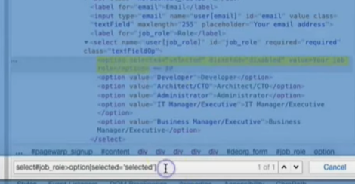
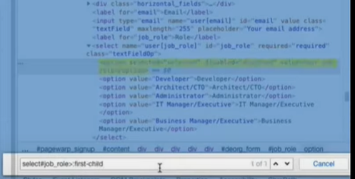
EXAMPLE (first-child)
Locating webElement normally without the first-child
Using first-child pseudo class (after selecting child, use :first-child)

Slide 15
Example - CONTINUED
EX {
Format: tag#ID>:first-child OR tag#ID>:last-child OR tag#ID>:nth-child(4)
Normal: select#job_role>:first-child
}
:nth-child requires the number that you want to select from list
:nth-child(4)
:nth-last-child(4) is the same as nth-child, it just counts from the end of list

Slide 16
CSS SELECTOR PSEUDO-CLASSES CONT.
first-of-type = Returns the first element of its type among a group of sibling elements
last-of-type = Returns the last element of its type among a group of sibling elements
nth-of-type = Matches elements of a given type, based on their position among a group of siblings.

Slide 17
EXAMPLE
EX
Format: tag#ID>:first-of-type OR tag#ID>:last-of-type
OR tag#ID>:nth-of-type(4)
Normal: select#job_role>:nth-of-type(4)
When to use? - Below a particular parent node, there can be diff types of webElements and you might be interested in a specific type which doesn't have any unique attributes

Slide 18
Are you bored?
EXERCISE: LENOVO WEBSITE - locate the little FB Logo at the bottom
Syntax: > and space ( )
This is an exercise to see how > and ( ) space work… I think

Slide 19


Thank You
D@VEED

